Slide 1
LED Lounge Furniture
Business Store

Slide 2
Large Flowerpot (32*32*74cm)

Slide 3
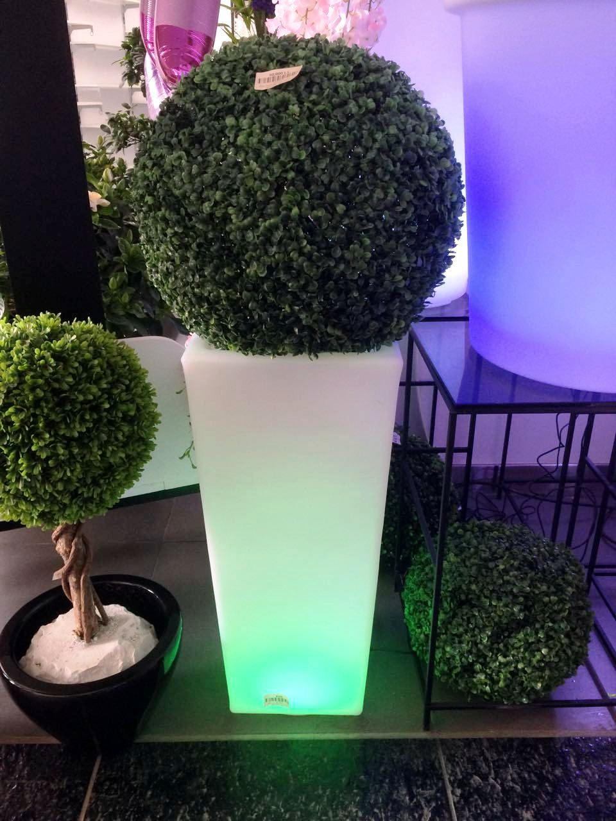
Large Flowerpot (32*32*74cm)

Slide 4
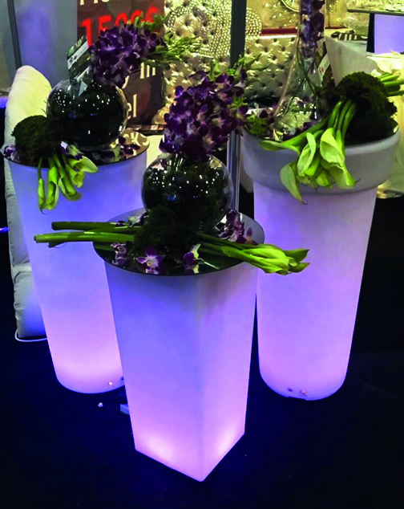
Large Flowerpot (32*32*74cm)

Slide 5
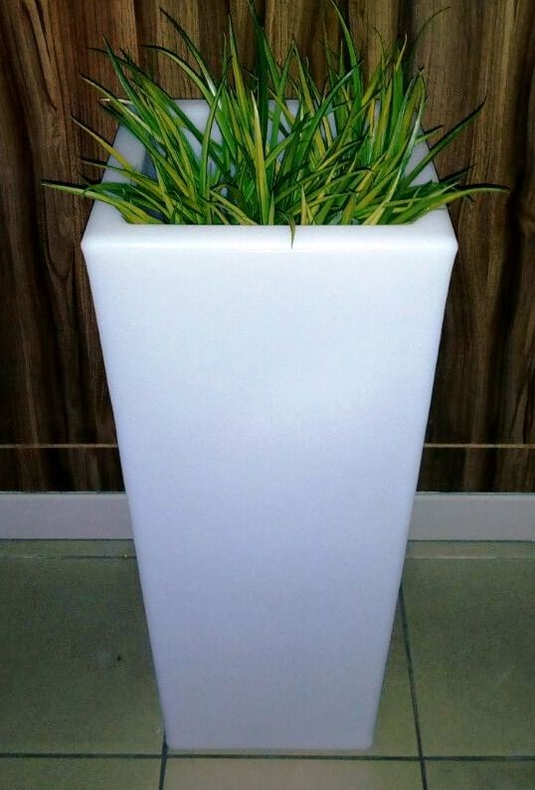
Large Flowerpot (32*32*74cm)

Slide 6
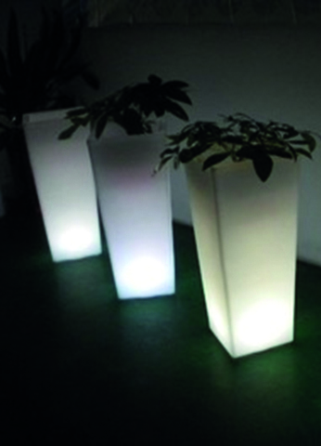
Large Flowerpot (32*32*74cm)

Slide 7
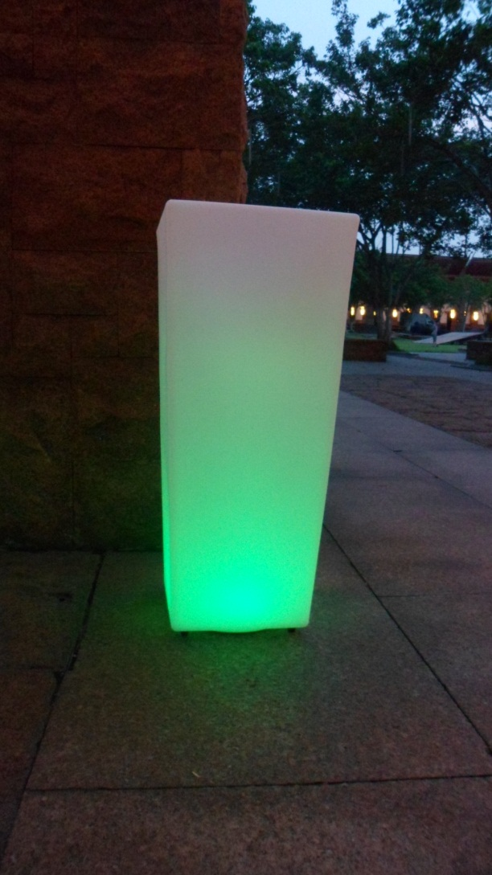
Large Flowerpot (32*32*74cm)

Slide 8
87cm Flowerpot (43*43*87cm)

Slide 9
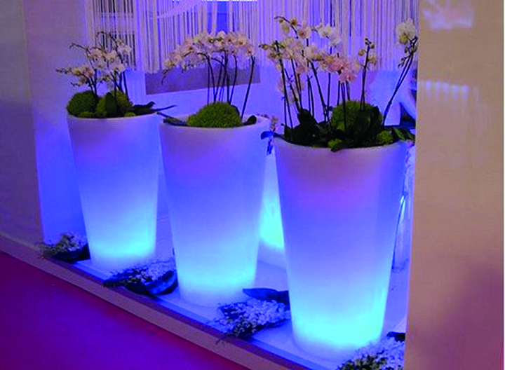
87cm Flowerpot (43*43*87cm)

Slide 10
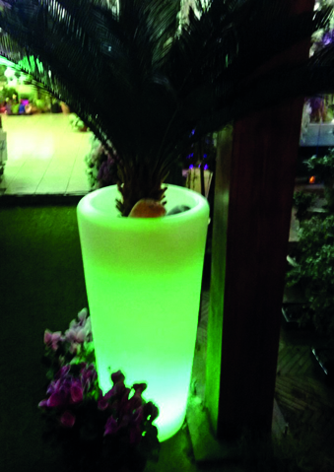
87cm Flowerpot (43*43*87cm)

Slide 11
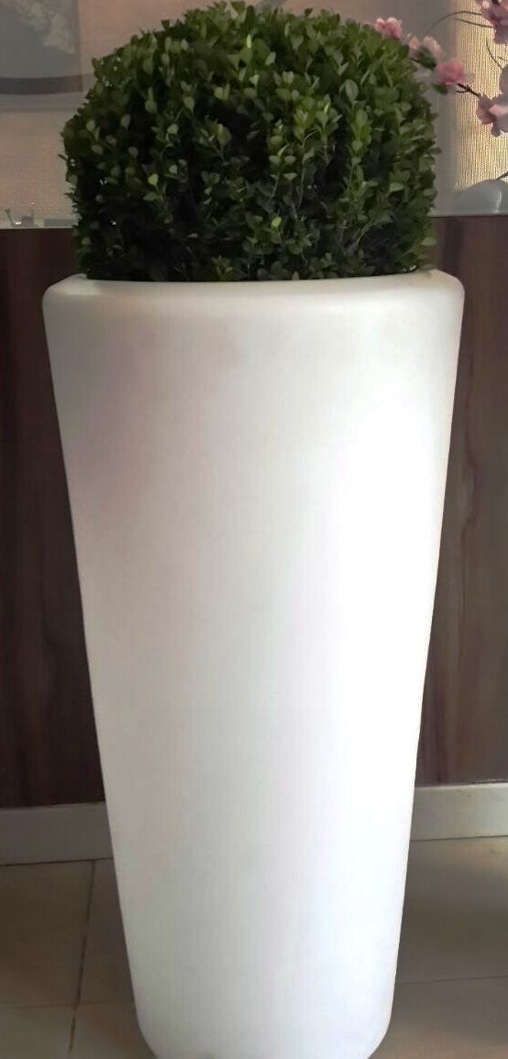
87cm Flowerpot (43*43*87cm)

Slide 12
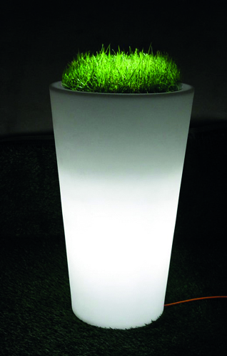
87cm Flowerpot (43*43*87cm)

Slide 13
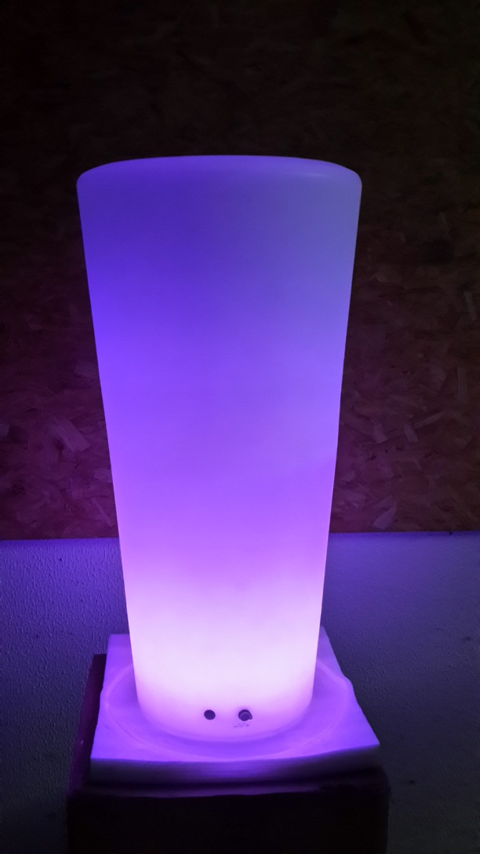
87cm Flowerpot (43*43*87cm)

Slide 14
68cm Flowerpot (60*60*68cm)

Slide 15
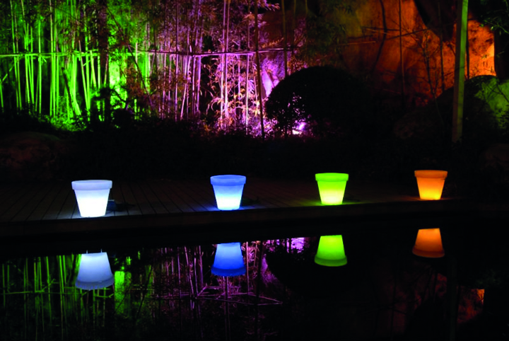
68cm Flowerpot (60*60*68cm)

Slide 16
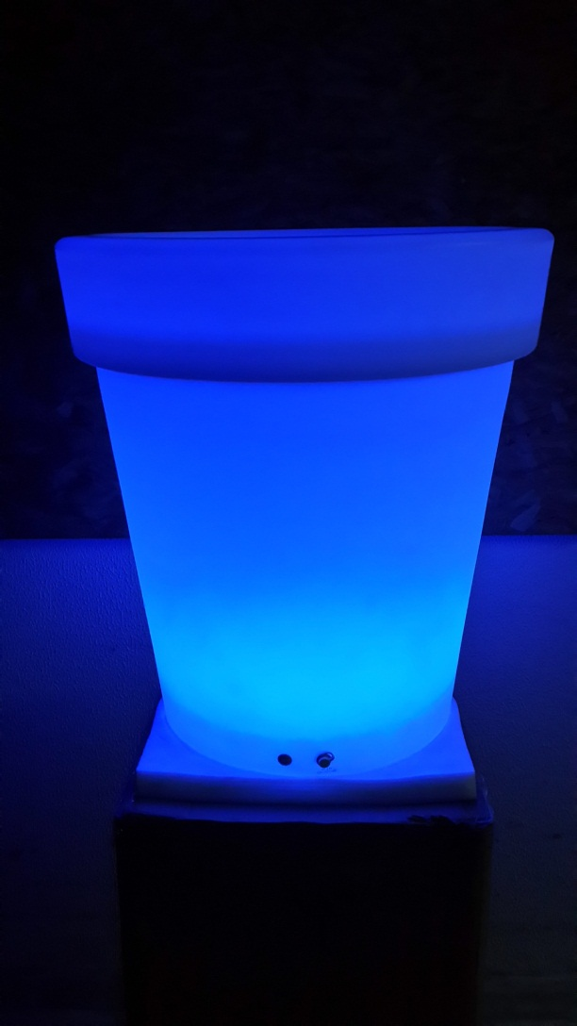
68cm Flowerpot (60*60*68cm)

Slide 17
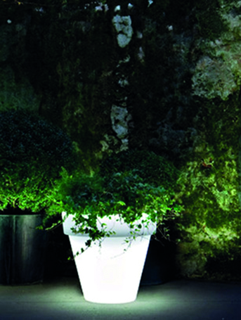
68cm Flowerpot (60*60*68cm)

Slide 18
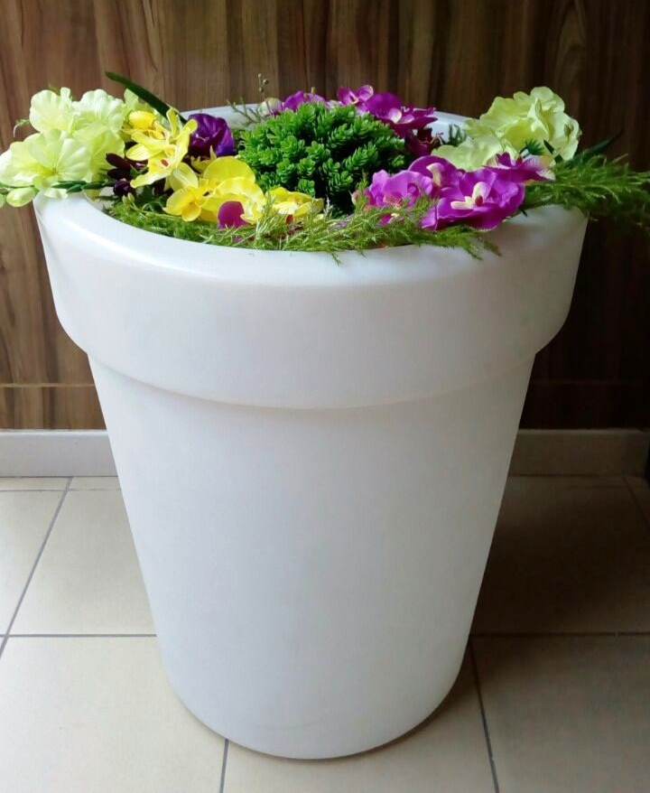
68cm Flowerpot (60*60*68cm)

Slide 19
95cm Flowerpot (48*48*95cm)

Slide 20
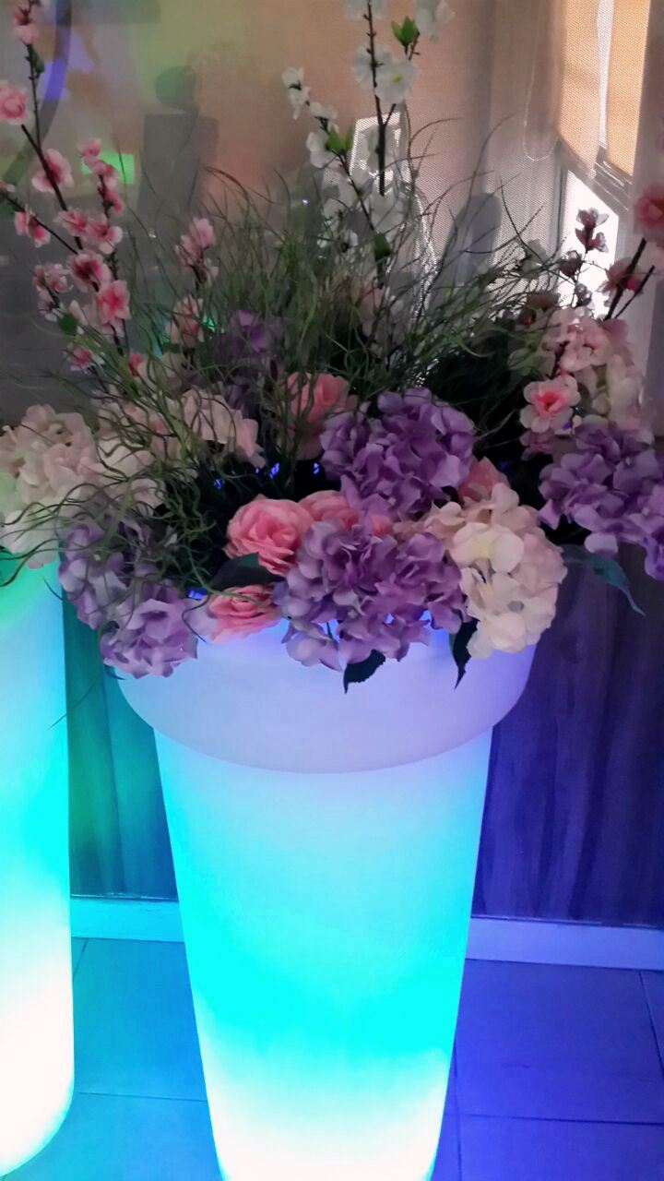
95cm Flowerpot (48*48*95cm)

Slide 21
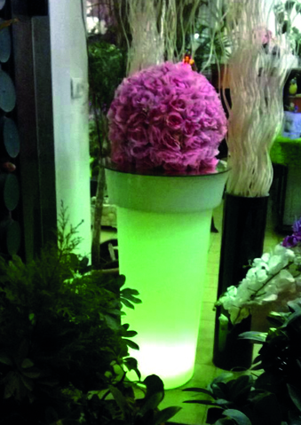
95cm Flowerpot (48*48*95cm)

Slide 22
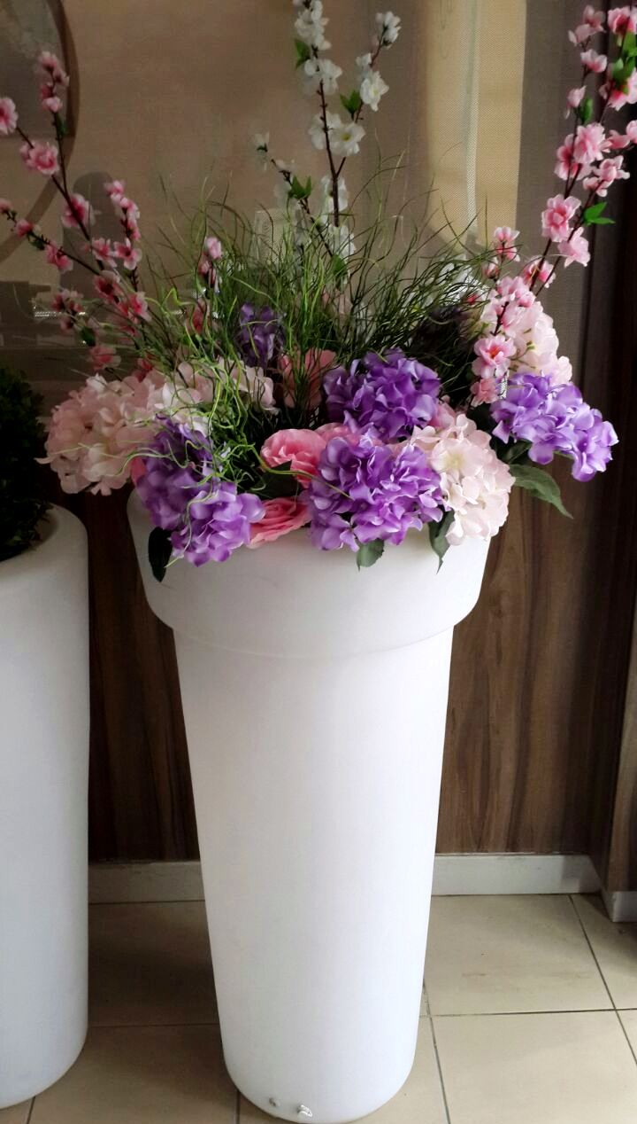
95cm Flowerpot (48*48*95cm)

Slide 23
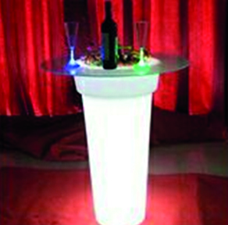
95cm Flowerpot (48*48*95cm)

Slide 24
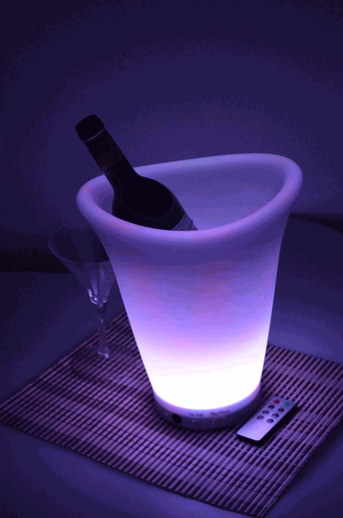
LED Ice/Wine Bucket

Slide 25
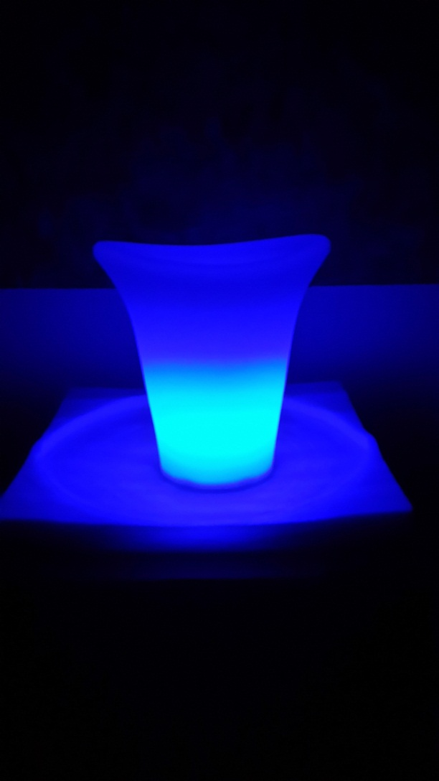
LED Ice/Wine Bucket

Slide 26
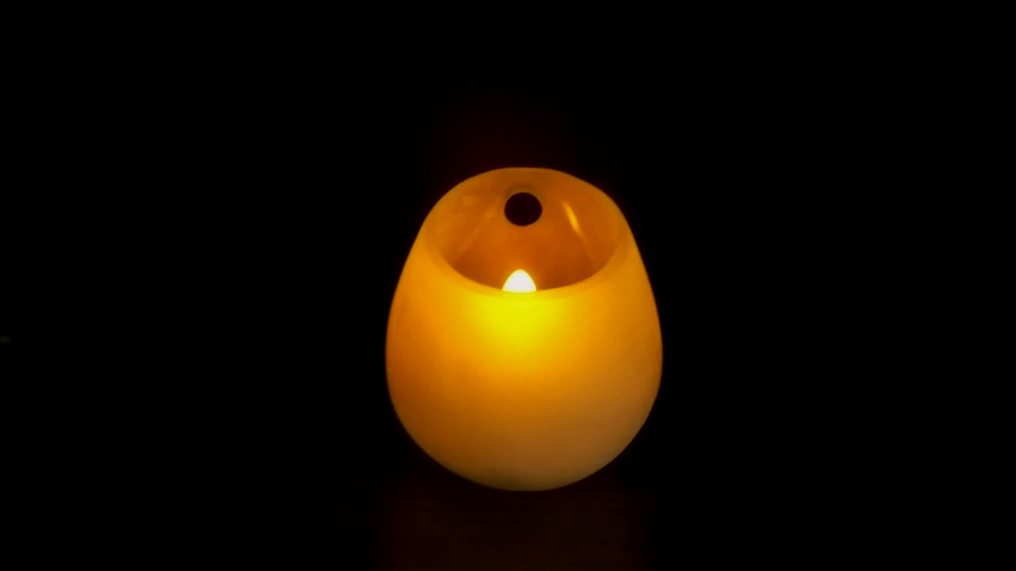
Candle lamp

Slide 27
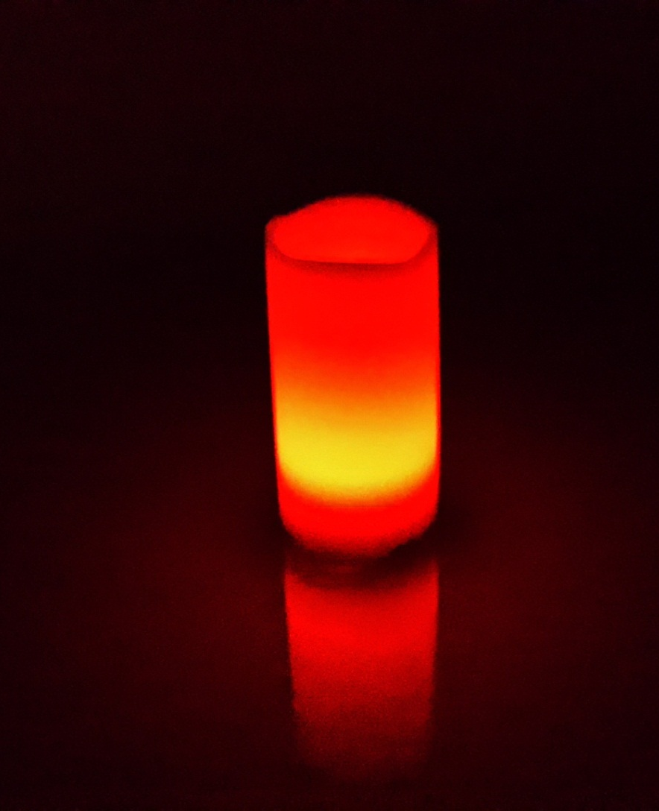
Multi-color LED Candle with Remote Control

Slide 28
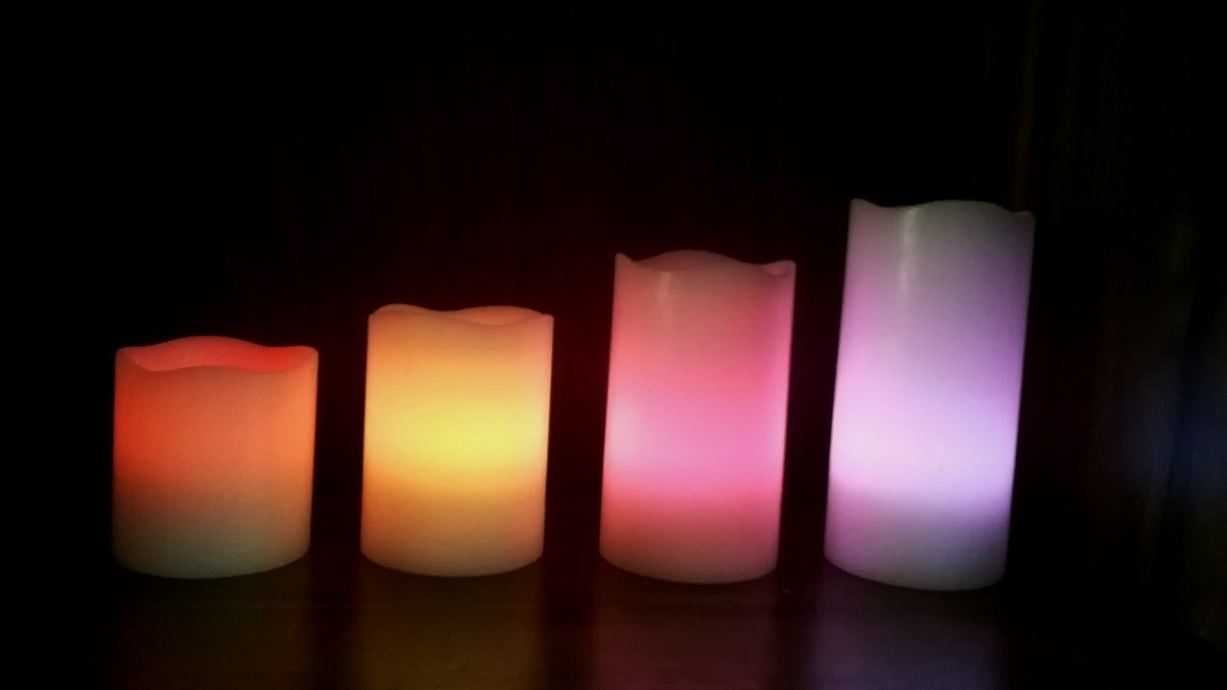
Multicolor Round Shape 4 Candle Rechargeable Set

Slide 29
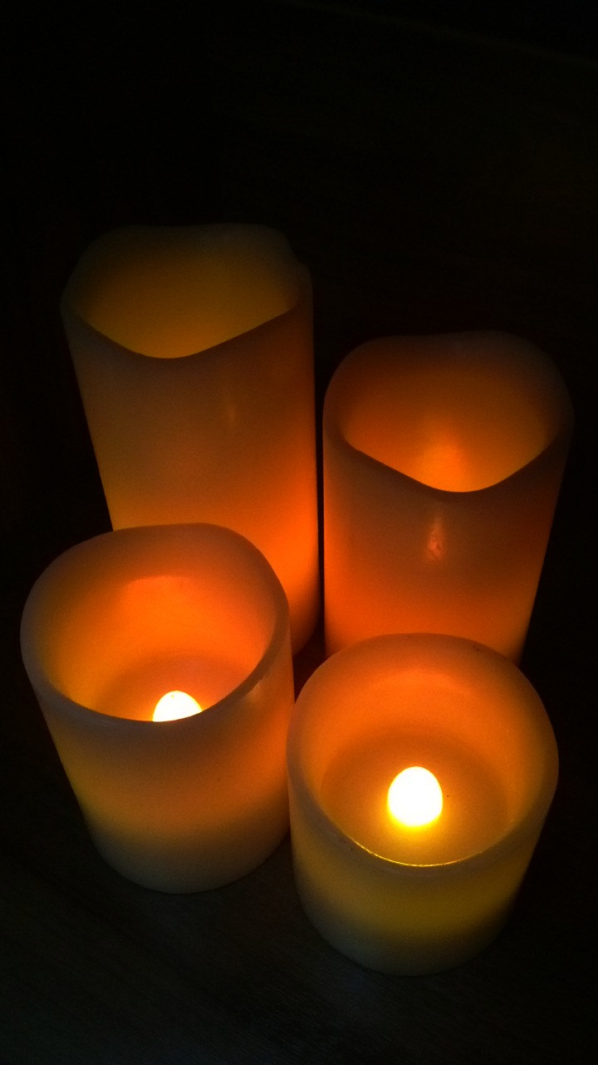
Multicolor Round Shape 4 Candle Rechargeable Set

Slide 30
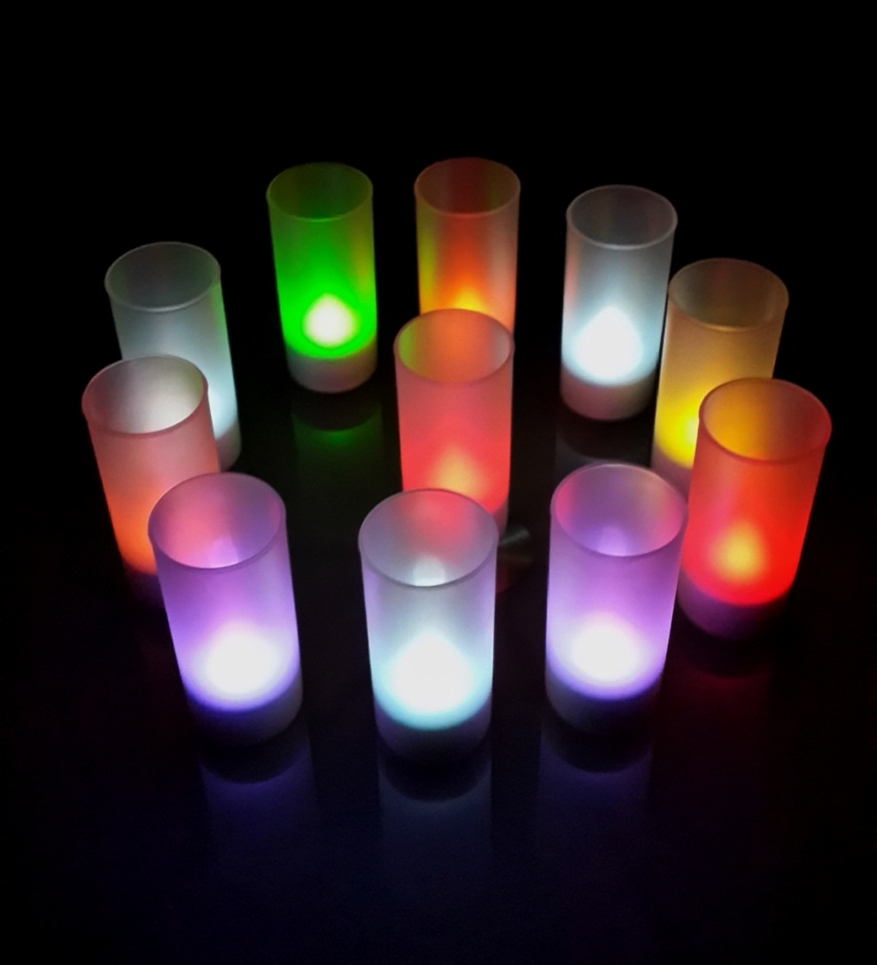
Selectable Flicker 12 Candle Rechargeable Set

Slide 31
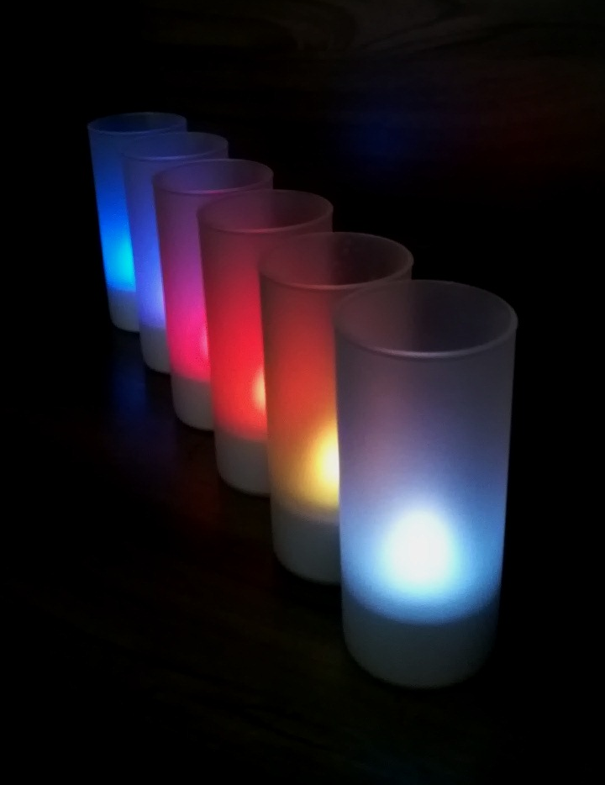
Selectable Flicker 12 Candle Rechargeable Set

